Slide 1
Applying Similarity
“You are getting sleepy….”
Kaitlyn O’Malley

Slide 2
Goals and Objectives
Goal: Students will apply their knowledge of similar triangles to multiple contexts.
Objectives:
Given a measuring tape, the students will find their eye heights in centimeters.
Using their eye heights and knowledge of similar triangles, the students will use proportions to find how far their partners will have to stand from the mirror in order to see each other’s eyes in the mirror.
The students will apply properties of right triangles to solve for the distance from their eyes to their partners eyes.

Slide 3
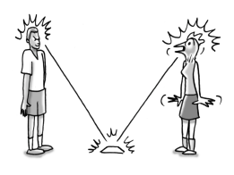
You are getting sleepy….
Legend has it that if you stare into a person’s eyes in a special way, you can hypnotize them into squawking like a chicken. Here’s how it works.
Place a mirror on the floor. Your
victim has to stand exactly 200 cm
away from the mirror and stare into it.
The only tricky part is that you need to
figure out where you have to stand so
that when you stare into the mirror, you
are also staring into your victim’s eyes.
If your calculations are correct and you stand at the exact distance, your victim will squawk like a chicken!

Slide 4
Materials
Set Up
Prior to the lesson, create a station in the room where the students can measure their eye-height.
Then place two measuring tapes (at least 250 cm) end-to-end on the ground so that their measurements increase in opposite directions.
Then tape a flat mirror on top of the joined ends of the measuring tapes.
Small flat mirror
Measuring tapes or meter sticks
Calculator

Slide 5
Procedure….
Break up into teams of 2 and chose a member of your team to hypnotize (Find someone that is a different height than you).
Determine where the hypnotizer will have to stand in order for the hypnosis to work.
Measure the heights of both yourself and your victim (from height of eyes).
$$Height of myself:146 cm$$
$$Height of my partner:167 cm$$

Slide 6
4. Sketch a diagram to represent this situation and label all the lengths you can on the diagram.
5. How many pairs of equal angles can you find in your diagram?
We can assume that both people will stand upright, and therefore both triangles have a right angle.
We also know (from a previous lesson) that light bounces off a mirror at the same angle it hits the mirror.
There are two pairs of equal angles in the diagram.

Slide 7
6. What is the relationship between the two triangles?
Since the triangles have 2 corresponding angles that are congruent, we know the triangles are similar.
We can use proportions to solve for the distance needed.
7. Calculate how far you will need to stand from the mirror to hypnotize your victim.
$$\frac{my height}{my distance from mirror}=\frac{partners height}{their distance from mirror}$$
$$\frac{146}{200}=\frac{167}{x}$$
$$146x=167∗200$$
$$146x=33,400$$
$$x=228.77$$

Slide 8
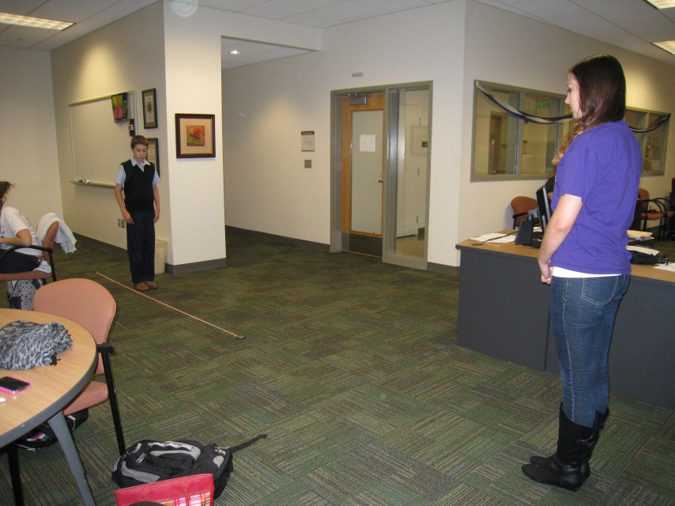
Moment of truth...
8. You stand 200 cm away from the mirror, while your teammate stands at the calculated distance from the mirror.
KEEP IN MIND where you place your feet when you are measuring your distance from the mirror. It makes a difference if you place your toes at your length rather than your heels.
Did you and your teammate make eye contact? If yes, SQUAWK LIKE A CHICKEN! If no, check your measurements and calculations and try again!

Slide 9
Follow up…
What do you think would happen to the distance if the victim was the same size as you? What about taller/shorter?
How could you find the distance from your eyes to your partners eyes?

Slide 10
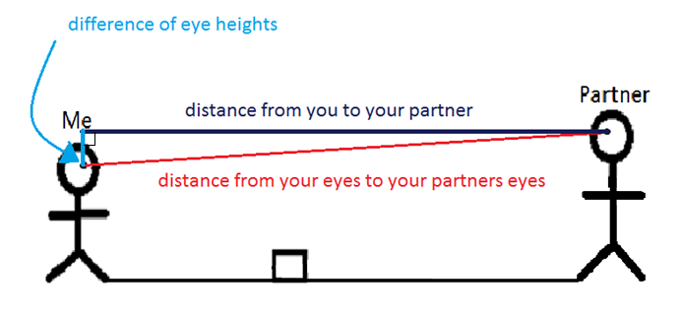
Distance from you to your partner
$$200+228.77$$
=$428.77 cm$
Difference of eye heights
$$167 −149$$
$$=18 cm$$
Distance from your eyes to your partners eyes
$$a^{2}+b^{2}=c^{2}$$
$${\left(18\right)}^{2}+{\left(428.77\right)}^{2}=x^{2}$$
$$324+183843.71=x^{2}$$
$$184167.71=x^{2}$$
$$x≈429.15 cm$$

Slide 11
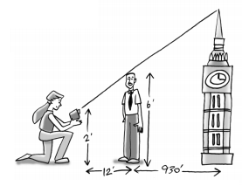
Other problems!
Lessons from abroad
Latoya was trying to take a picture of her family in front of the Big Ben clock tower in London. However, after she snapped the photo, she realized that the top of her father’s head exactly blocked the top of the clock tower!
While disappointed with the picture, Latoya thought she might be able to estimate the height of the tower using her math knowledge. Since Latoya took the picture while kneeling, the camera was 2 feet above the ground. The camera was also 12 feet from her 6-foot tall father, and he was standing about 930 feet from the base of the tower.
Sketch the diagram and locate as many triangles as you can. Do you see any similar triangles?
Use the similar triangles to determine the height of the clock tower.

Slide 12
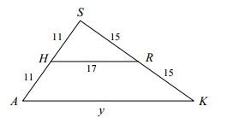
Other problems!
Triangle Challenge
Use what you know about triangles and angle relationships to answer these questions
about the diagram below. As you work, make a careful record of your reasoning (including a flowchart for any similarity arguments) and be ready to share it with the
class.
First challenge: Find y.
2. Second challenge: Is HR parallel to AK? How do you know?

Slide 13
Adapted from:
http://www.cpm.org/pdfs/information/GC_Ch3_2006_TV.pdf

